Slide 1


Faheem Ayub
Nov, 04th 2025

Slide 2

Outline
Executive Summary
Introduction
Methodology
Results
Conclusion
Appendix

Slide 3
Executive Summary
We will predict the successful landing of the SpaceX Falcon 9 first stage or otherwise, using machine learning classification algorithms
Main steps of the project:
Data collection using SpaceX API and web scraping
Exploratory data analysis (EDA) ), including data wrangling, data visualization and interactive visual analytics
Machine learning prediction
Result Summary
It was possible to collect valuable data from public sources
EDA allowed to identify which features are the best to predict success of launchings
Machine Learning Prediction showed the best model to predict which characteristics are important to drive this opportunity in the best way, using all collected data

Slide 4
Introduction
The objective is to evaluate the viability of the new company Space Y to compete with Space X.
We will predict if the Falcon 9 first stage will land successfully
SpaceX advertises Falcon 9 rocket launches on its website with a cost of 62 million dollars; other providers cost upward of 165 million dollars each
Savings is because SpaceX can reuse the first stage. Therefore, if we can determine if the first stage will land, we can determine the cost of a launch.
This information can be used by Space Y for a rocket launch
The main question: for a given set of features about a Falcon 9 rocket launch which include its payload mass, orbit type, launch site, and so on, will the first stage of the rocket land successfully
Desirable answers:
The best way to estimate the total cost for launches, by predicting successful landings of the first stage of rockets
Where is the best place to make launches

Slide 5

Section 1

Slide 6
Methodology
Our analysis comprised the following four stages:-
Data collection, wrangling, and formatting, using:
SpaceX API (https://api.spacexdata.com/v4/rockets/ )
Web scraping (https://en.wikipedia.org/wiki/List_of_Falcon/_9/_and_Falcon_Heavy_launches)
Perform data wrangling
Collected data was enriched by creating a landing outcome label based on outcome data after summarizing and analyzing features
Exploratory data analysis (EDA), using:
Pandas and NumPy
SQL
Data visualization, using:
Matplotlib and Seaborn
Folium
Dash
Machine learning prediction, using
Logistic regression
Support vector machine (SVM)
Decision tree
K-nearest neighbors (KNN)

Slide 7
Data Collection
Data sets were collected from Space X API (https://api.spacexdata.com/v4/rockets/ and from Wikipedia (https://en.wikipedia.org/wiki/List_of_Falcon/_9/_and_Falcon_Heavy_launches), using web scraping techniques.

Slide 8
Data Collection – SpaceX API
SpaceX API https://api.spacexdata.com/v4/rockets/
The API provides data about many types of rocket launches done by SpaceX; the data is therefore filtered to include only Falcon 9 launches
Every missing value in the data is replaced with the mean of the column that the missing value belongs to
We end up with 90 rows or instances and 17 columns or features. The picture shows first few rows of the data
Source Code: https://github.com/proudfirst-debug/Data-Science-capstone-project/blob/main/jupyter-labs-spacex-data-collection-api.ipynb
Request API, Parse launch data
Filtration to Falcon9 launches
Replacing missing values

Slide 9
Data Collection - Scraping
Web scraping was done using https://en.wikipedia.org/wiki/List_of_Falcon_9_and_Falcon_Heavy_launches
The website contains only the data about Falcon 9 launches.
We end up with 121 rows or instances and 11 columns or features. The picture below shows the first few rows of the data
Source Code: https://github.com/proudfirst-debug/Data-Science-capstone-project/blob/main/jupyter-labs-webscraping.ipynb
Use Wiki page for Falcon9 Launch
Extract Colum names from HTML
Create dataframe by Parsing

Slide 10
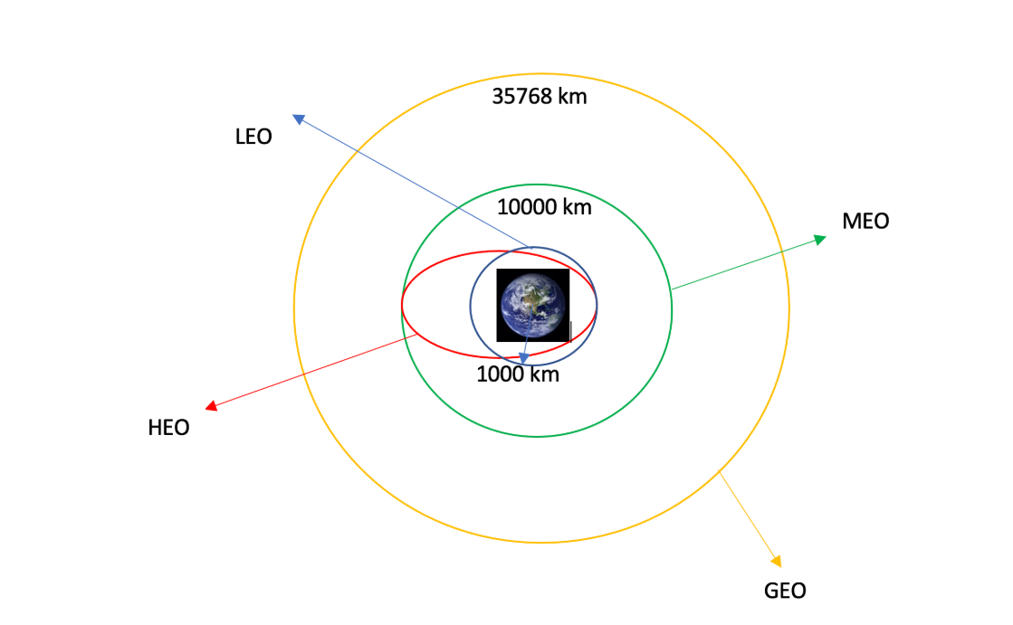
Data Wrangling
Missing values and column type were identified
Frequencies of occurrences of various launch sites and orbits were identified
Mission outcome of each orbit was identified and label for outcome were assigned; 1 = success, 0 = failure
Source Code: https://github.com/proudfirst-debug/Data-Science-capstone-project/blob/main/labs-jupyter-spacex-Data%20wrangling.ipynb
EDA
Summary
Landing outcome label

Slide 11
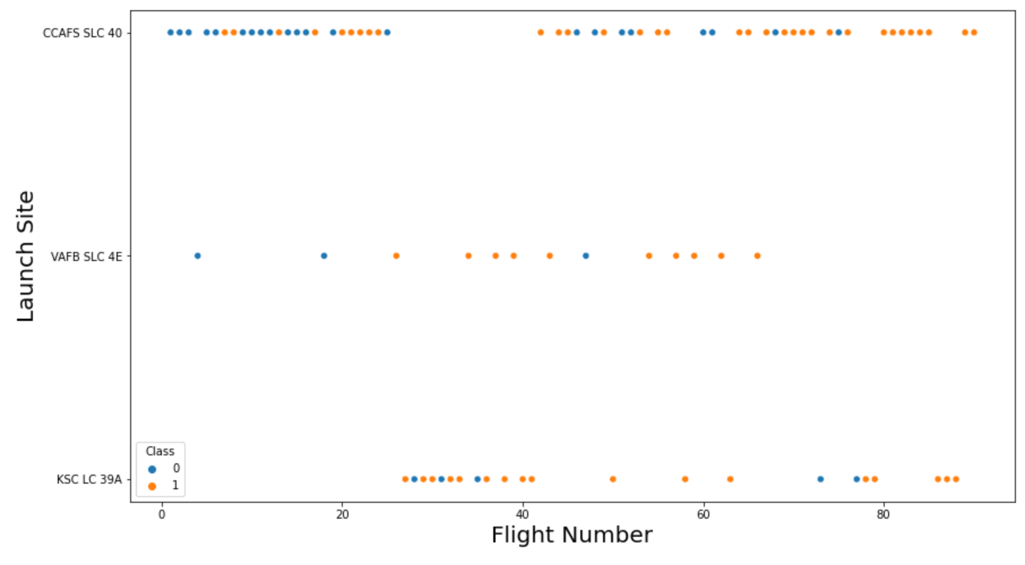
EDA with Data Visualization
Pandas and NumPy
Functions from the Pandas and NumPy libraries are used to derive basic information about the data collected, Charts include:
Scatter: Flight number and payload vs launch site. Flight number and payload vs Orbit.
Bar: Success rate by Orbit
Line Plot: The number and occurrence of each mission outcome
https://github.com/proudfirst-debug/Data-Science-capstone-project/blob/main/edadataviz.ipynb

Slide 12
EDA with SQL
The data is queried using SQL to answer several questions about the data such as:
The names of the unique launch sites in the space mission
The total payload mass carried by boosters launched by NASA (CRS)
The average payload mass carried by booster version F9 v1.1
Date when the first successful landing outcome
Names of the boosters which have success in drone ship and have payload mass between 4000 and 6000 kg
Total number of successful and failure mission outcomes
Names of the booster versions which have carried the maximum payload mass
https://github.com/proudfirst-debug/Data-Science-capstone-project/blob/main/jupyter-labs-eda-sql-coursera_sqllite.ipynb

Slide 13
Build an Interactive Map with Folium
Functions from the Folium libraries are used to visualize the data through interactive maps.
The Folium library is used to:
Mark all launch sites on a map
Mark the succeeded launches and failed launches for each site on the map
Mark the distances between a launch site to its proximities such as the nearest city, railway, or highway
Various objects were added to know insight on:
Are launch sites in close proximity to railways?
Are launch sites in close proximity to highways?
Are launch sites in close proximity to coastline?
Do launch sites keep certain distance away from cities?
https://github.com/proudfirst-debug/Data-Science-capstone-project/blob/main/lab_jupyter_launch_site_location.ipynb

Slide 14
Build a Dashboard with Plotly Dash
Functions from Dash are used to generate an interactive site where we can toggle the input using a dropdown menu and a range slider.
Using a pie chart and a scatterplot, the interactive site shows:
The total success launches from each launch site
The correlation between payload mass and mission outcome (success or failure) for each launch site
These plots gave interactive information on successes on each launch site and correlation between payload mass and mission outcome of each launchsite
https://github.com/proudfirst-debug/Data-Science-capstone-project/blob/main/spacex_dash_app_fa.py

Slide 15
Predictive Analysis (Classification)
Functions from the Scikit-learn library are used to create our machine learning models.
The machine learning prediction phase include the following steps:
Standardizing the data
Splitting the data into training and test data
Creating machine learning models, which include:
Logistic regression
Support vector machine (SVM)
Decision tree
K nearest neighbors (KNN)
Fit the models on the training set
Find the best combination of hyperparameters for each model
Evaluate the models based on their accuracy scores and confusion matrix
https://github.com/proudfirst-debug/Data-Science-capstone-project/blob/main/SpaceX_Machine%20Learning%20Prediction_Part_5.ipynb
Data Prep
Model testing
Result comparison

Slide 16

Results
Exploratory data analysis results:
Space X uses 4 different launch sites
The first launches were done to Space X itself and NASA
The average payload of F9 v1.1 booster is 2,928 kg
The first success landing outcome happened in 2015 fiver year after the first launch
Many Falcon 9 booster versions were successful at landing in drone ships having payload above the average (Almost 100% of mission outcomes were successful)
Two booster versions failed at landing in drone ships in 2015: F9 v1.1 B1012 and F9 v1.1 B1015
The number of landing outcomes became as better as years passed

Slide 17
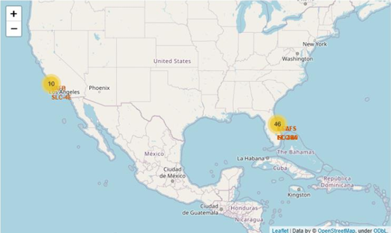
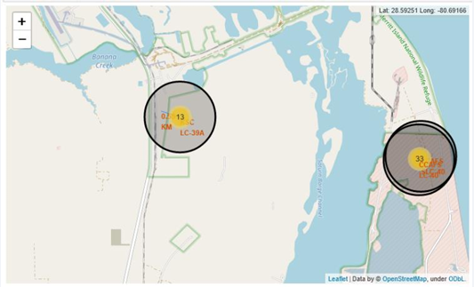
Results
Using interactive analytics, it was possible to identify that launch sites used to be in safe places, near the sea, for example and have a good logistic infrastructure around
Most launches happened at launch sites of East Coast

Slide 18
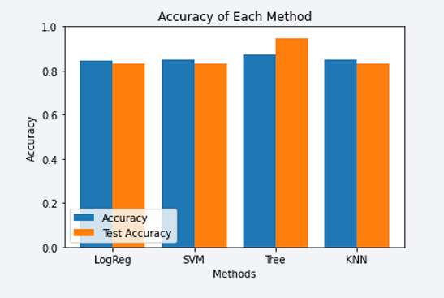
Results
Predictive Analysis showed that the Decision Tree Classifier is the best model to predict successful landings
Accuracy over 87% and accuracy for test data over 94%

Slide 19

Section 2

Slide 20
Flight Number vs. Launch Site
Top best launch sites
CCAF5 SLC 40
VAFB SLC 4E
KSC LC 39A
General success rate improved over time

Slide 21
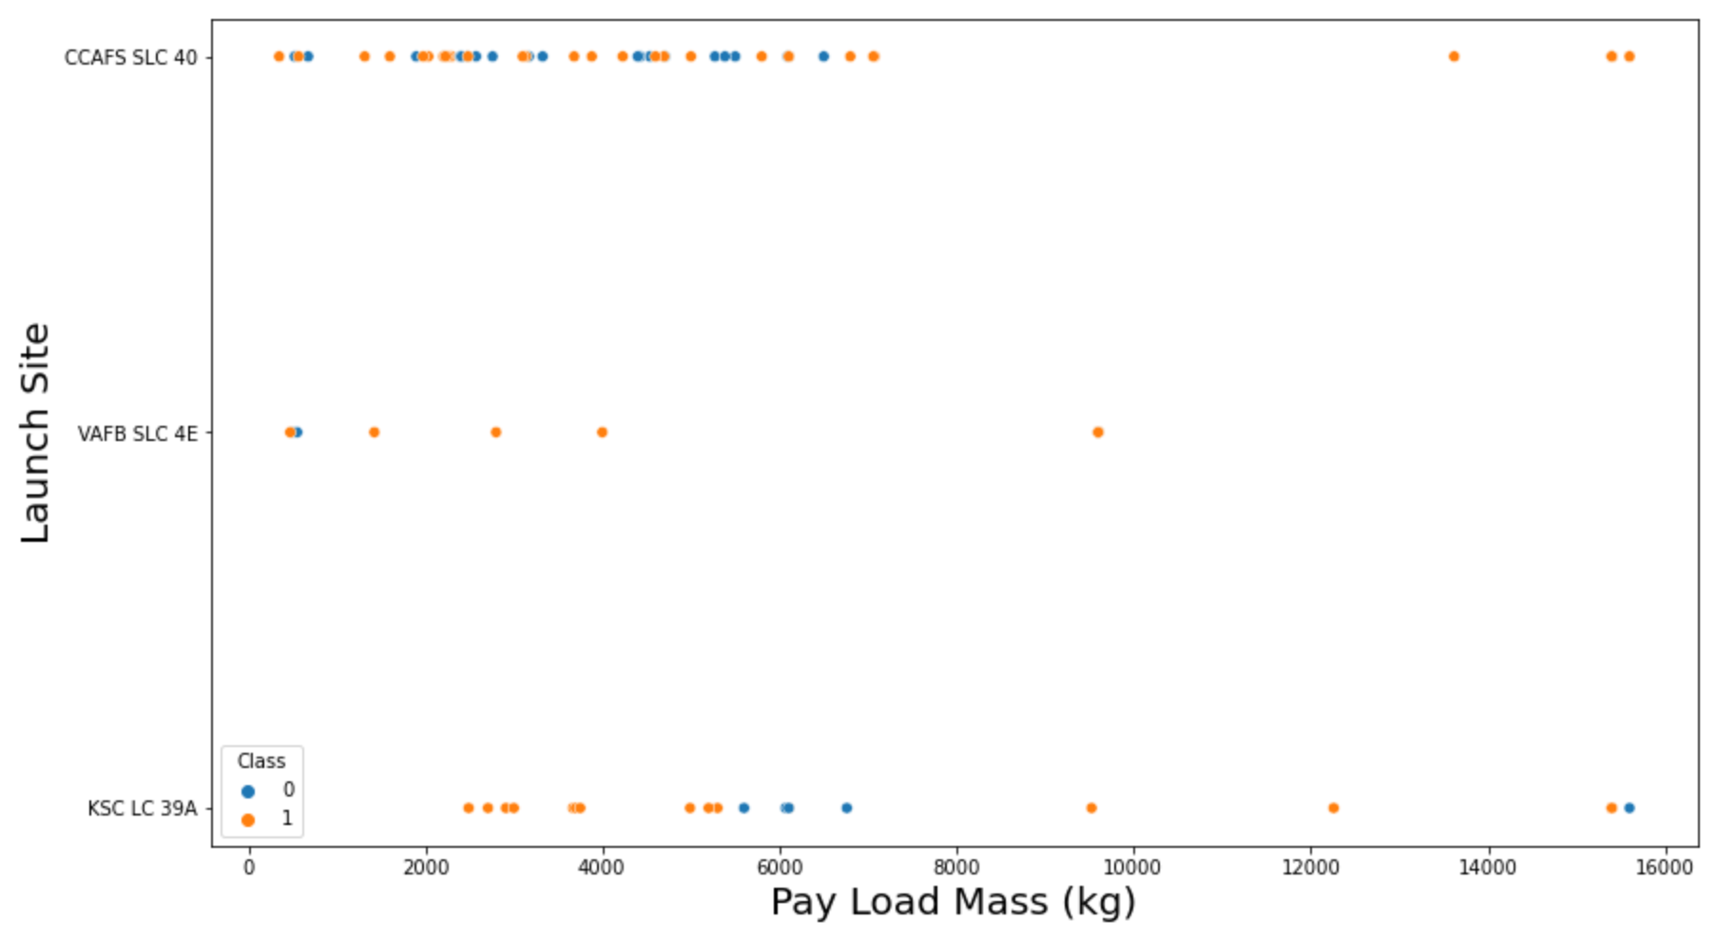
Payload vs. Launch Site
Over 9,000kg payload have an excellent success rate
Over 12,000kg payloads seem to be possible only on CCAFS SLC 40 and KSC LC 39A launch sites

Slide 22
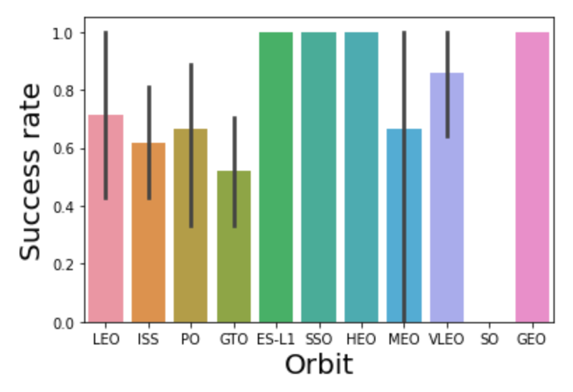
Success Rate vs. Orbit Type
The highest success rate orbits are:
ES-L1
GEO
HEO
SSO

Slide 23
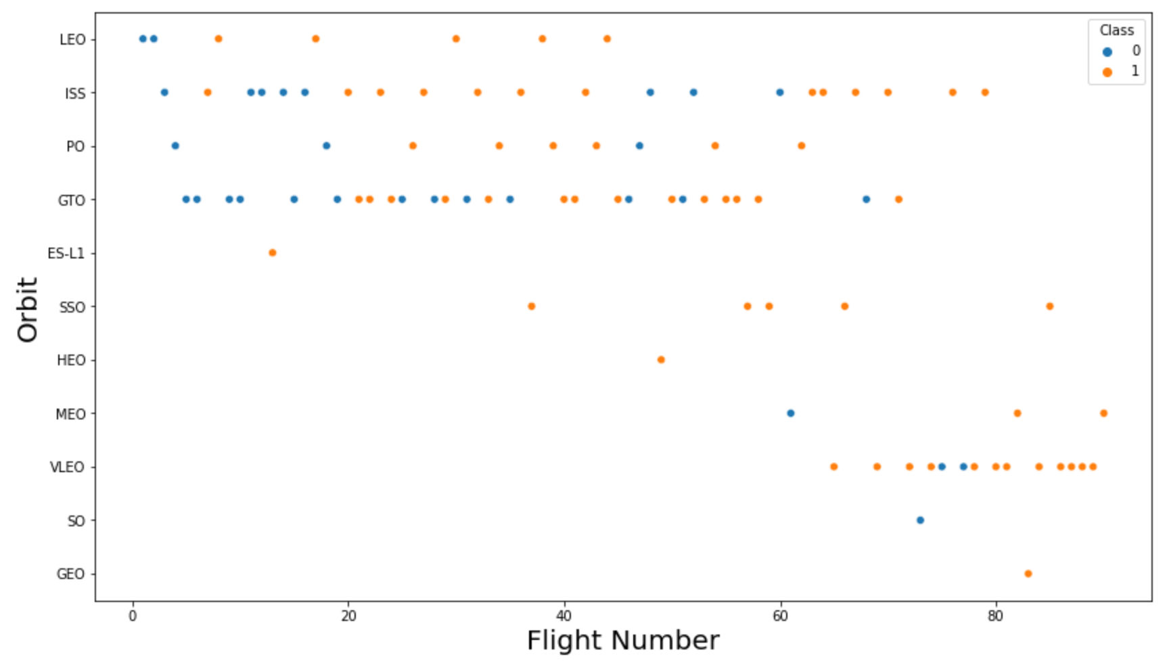
Flight Number vs. Orbit Type
Success rate improved over time to all orbits
VLEO orbit seems a new business opportunity (increase of its frequency)

Slide 24
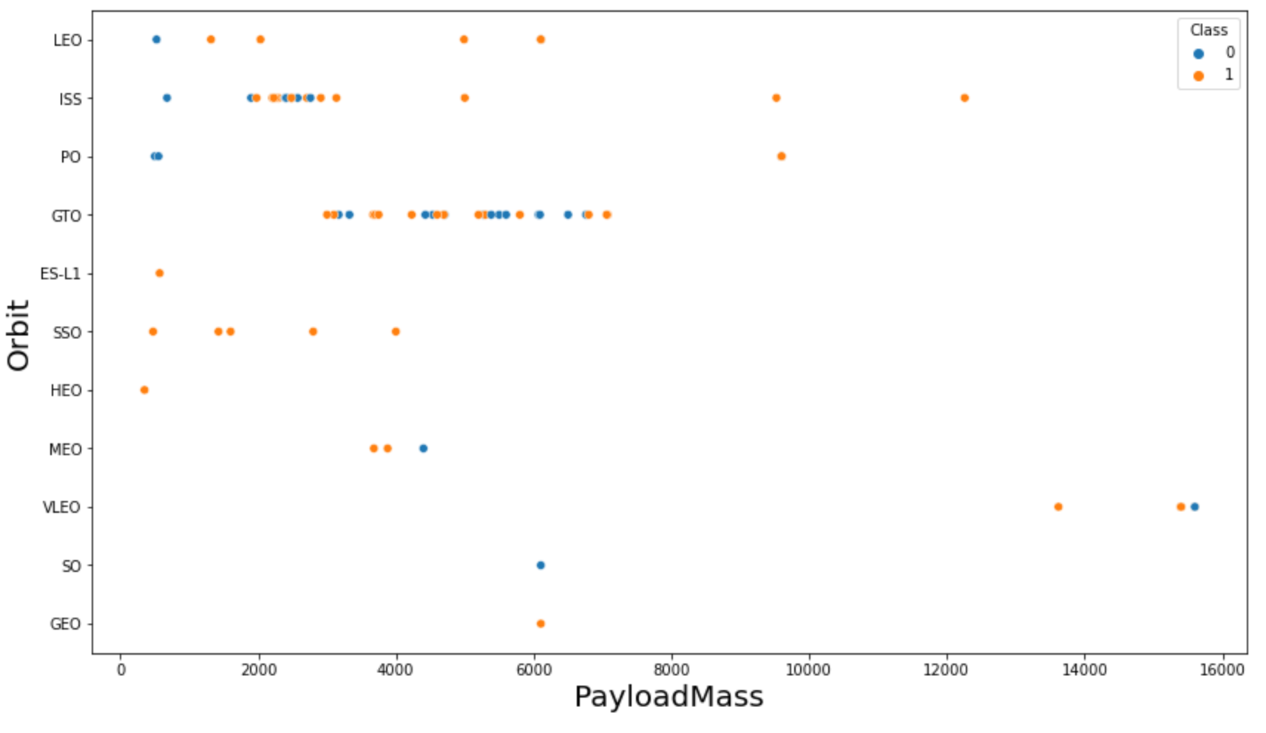
Payload vs. Orbit Type
No relation between payload and success rate to orbit GTO
ISS orbit has the widest range of payload and a good rate of success
There are few launches to the orbits SO and GEO

Slide 25
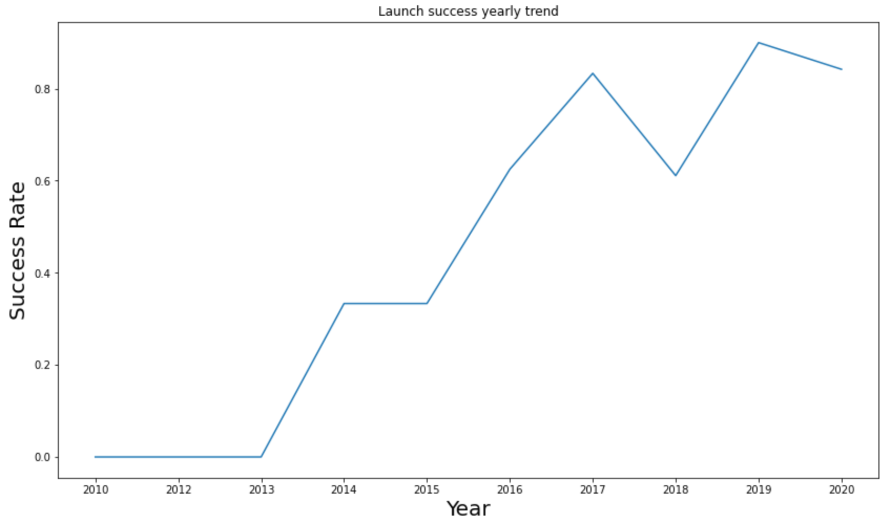
Launch Success Yearly Trend
First three years have no success
Success rate started increasing in 2013 and continued until 2020

Slide 26
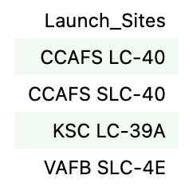
All Launch Site Names
Four launch sites
CCAFS LC-40
CCAFS SLC-40
KSC LC-39A
VAFB SLC-4E
Otained by selecting unique occurrences of “launch_site” values

Slide 27
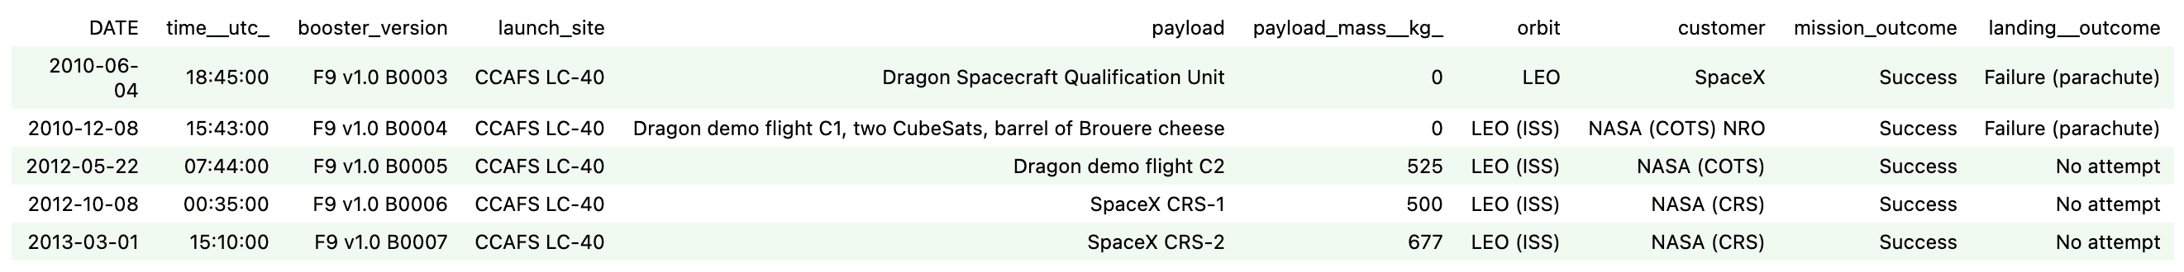
Launch Site Names Begin with 'CCA'
Find 5 records where launch sites begin with `CCA`
Here we can see five samples of Cape Canaveral launches

Slide 28
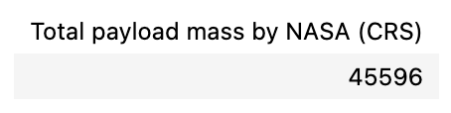
Total Payload Mass
The total payload mass carried by boosters launched by NASA (CRS)
Total payload calculated above, by summing all payloads whose codes contain ‘CRS’, which corresponds to NASA.

Slide 29
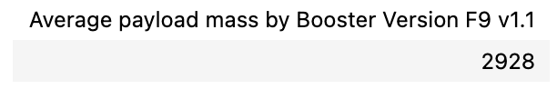
Average Payload Mass by F9 v1.1
Filtering data by the booster version above and calculating the average payload mass we obtained the value of 2,928 kg for booster version F9 v1.1

Slide 30
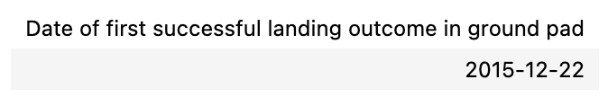
First Successful Ground Landing Date
By filtering data by successful landing outcome on ground pad and getting the minimum value for the date, it’s possible to identify the first occurrence: Min Date 2015-12-22

Slide 31
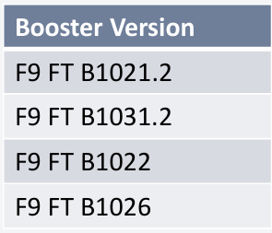
Successful Drone Ship Landing with Payload between 4000 and 6000
Four boosters have success in drone ship and have payload mass greater than 4000 but less than 6000, these are:
F9 FT B1021.2
F9 FT B1031.2
F9 FT B1022
F9 FT B1026

Slide 32
Total Number of Successful and Failure Mission Outcomes
Number of successful and failure mission outcomes
Success 99
Success (payload status unclear) 1
Failure (in flight) 1
Grouping mission outcomes and counting records for each group led us to the summary above

Slide 33
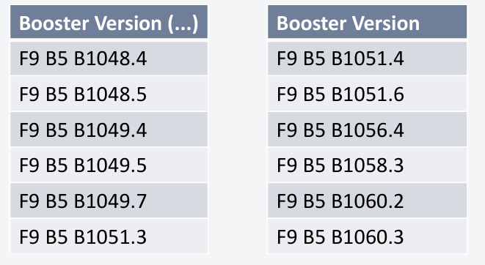
Boosters Carried Maximum Payload
Boosters which have carried the maximum payload mass
These are the boosters which have carried the maximum payload mass registered in the dataset

Slide 34
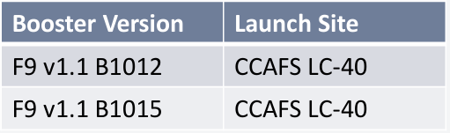
2015 Launch Records
Failed landing outcomes in drone ship, their booster versions, and launch site names for the year 2015
F9 v1.1 B1012 CCAFS LC-40
F9 v1.1 B1015 CCAFS LC-40
The list above has only two occurrences

Slide 35
Rank Landing Outcomes Between 2010-06-04 and 2017-03-20
Ranking of all landing outcomes between the date 2010-06-04 and 2017 03-20
This view of data alerts us that “No attempt” must be taken in account
Landing Outcomes | Occurrences
No attempt | 10
Failure - drone ship | 5
Success - drone ship | 5
Controlled – ocean | 3
Success - Ground pad | 3
Failure – parachute | 2
Uncontrolled – ocean | 2
Precluded – drone ship | 1

Slide 36

Section 3

Slide 37
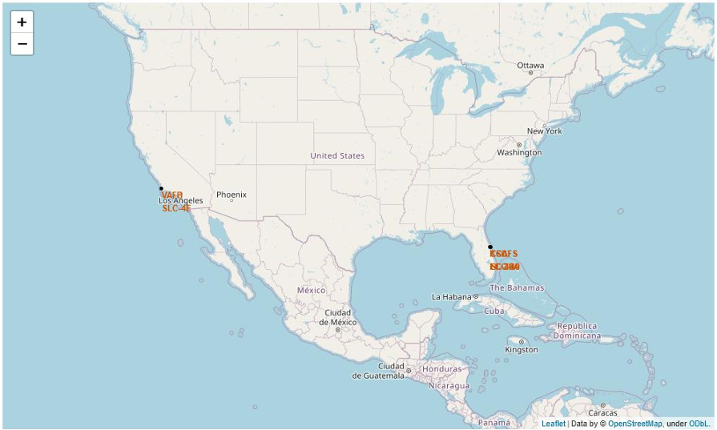
Launch Sites (All)
Launch sites are near sea, probably by safety, but not too far from roads and 38 railroads

Slide 38
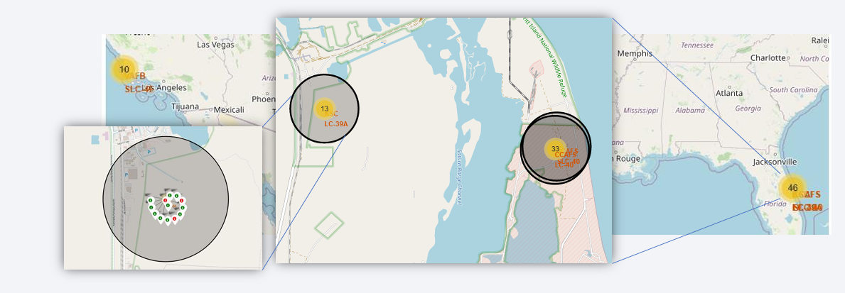
<Folium Map Screenshot 2>
Green markers indicate successful and red ones indicate failure
Green markers indicate successful and red ones indicate failure

Slide 39
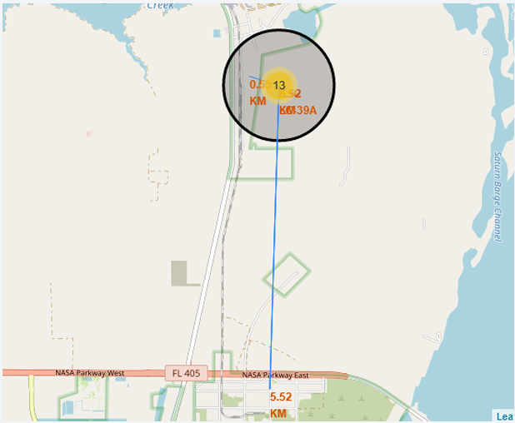
Safety
Launch site KSC LC-39A has good logistics aspects, being near railroad and road and relatively far from inhabited areas

Slide 40

Section 4

Slide 41
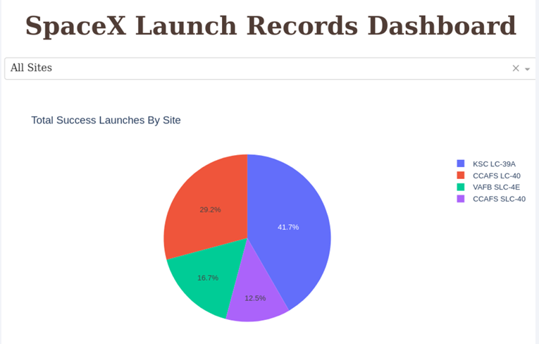
Successful Launch Sites
Launch site plays important role in success

Slide 42
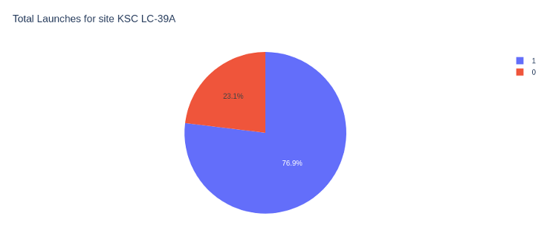
KSC LC-39A – Launch Success
76.9% of launches are successful

Slide 43
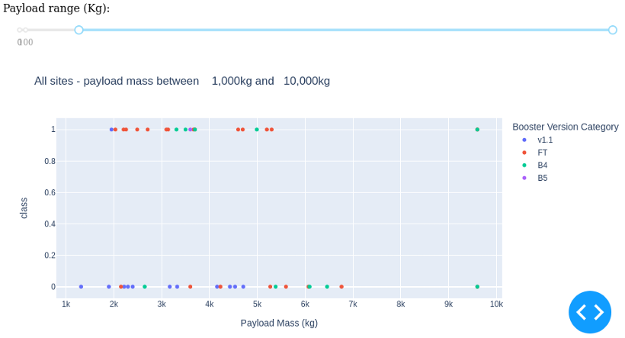
Launch Outcome vs Payload
The most successful combination: Payloads under 6,000kg and FT boosters

Slide 44

Section 5

Slide 45
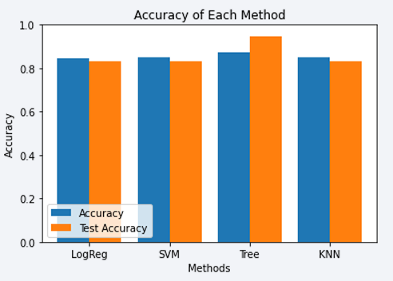
Classification Accuracy
Four classification models were tested, and their accuracies are plotted
The model with the highest classification accuracy is the Decision Tree Classifier, which has an accuracy of over 87%

Slide 46
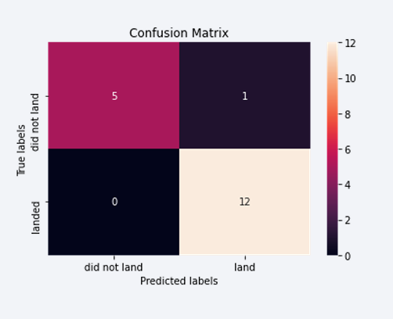
Confusion Matrix
Confusion matrix of Decision Tree Classifier proves its accuracy by showing the big numbers of true positive and true negative

Slide 47
Conclusions
Different data sources were analyzed, refining conclusions along the process
The best launch site is KSC LC-39A
Successful landing outcomes seem to improve over time
Decision Tree Classifier can be used to predict successful landings and increase profits

Slide 48
Appendix
GitHub Repository of the complete project
https://github.com/proudfirst-debug/Data-Science-capstone-project

Slide 49


